Slide 1

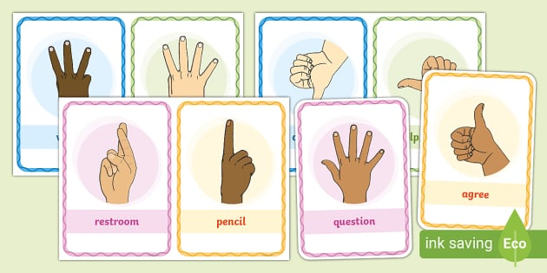
AI POWERED SIGN LANGUAGE TRANSLATOR USING
RASPBERRY PI5
Sucharita Gorai

Slide 2


CONTENTS
Introduction
Literature Survey
Design Scheme
Testing, Analysis, And Evaluation
Socio-economic Issues Associated With The Project
Engineering Tools And Standards
Conclusion

Slide 3



INTRODUCTION
This project focuses on designing and implementing an AI-powered sign language translator using a Raspberry Pi.
The primary goal of this system is to translate recognized sign language gestures into readable text or synthesized speech, enabling smoother, two-way communication between sign language users and non-signers.
Through this project, we aim to demonstrate how AI and embedded systems can
be combined to create practical solutions that address real-world social
challenges.

Slide 4

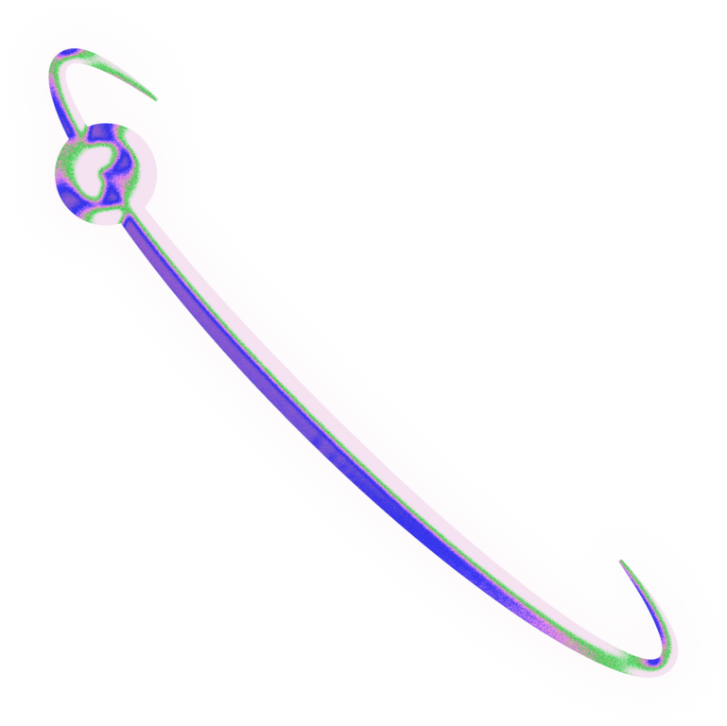
Recent Framework by Google AI
Feature: Real-time hand tracking and landmark detection using a webcam.
Relevance: Highly accurate and lightweight, suitable for implementation on Raspberry Pi with optimized models.
Recent Framework by Google AI
Feature: Real-time hand tracking and landmark detection using a webcam.
Relevance: Highly accurate and lightweight, suitable for implementation on Raspberry Pi with optimized models.
Recent Framework by Google AI
Feature: Real-time hand tracking and landmark detection using a webcam.
Relevance: Highly accurate and lightweight, suitable for implementation on Raspberry Pi with optimized models.
Recent Framework by Google AI
Feature: Real-time hand tracking and landmark detection using a webcam.
Relevance: Highly accurate and lightweight, suitable for implementation on Raspberry Pi with optimized models.
Recent Framework by Google AI
Feature: Real-time hand tracking and landmark detection using a webcam.
Relevance: Highly accurate and lightweight, suitable for implementation on Raspberry Pi with optimized models
Recent Framework by Google AI
Feature: Real-time hand tracking and landmark detection using a webcam.
Relevance: Highly accurate and lightweight, suitable for implementation on Raspberry Pi with optimized models
Recent Framework by Google AI
Feature: Real-time hand tracking and landmark detection using a webcam.
Relevance: Highly accurate and lightweight, suitable for implementation on Raspberry Pi with optimized models
Recent Framework by Google AI
Feature: Real-time hand tracking and landmark detection using a webcam.
Relevance: Highly accurate and lightweight, suitable for implementation on Raspberry Pi with optimized models
Feature: Real-time hand tracking and landmark detection using a webcam.
Feature: Real-time hand tracking and landmark detection using a webcam.
Feature: Real-time hand tracking and landmark detection using a webcam.
Feature: Real-time hand tracking and landmark detection using a webcam.
Feature: Real-time hand tracking and landmark detection using a webcam.
Gesture Recognition Using MediaPipe
Real-Time Hand Gesture Recognition with Raspberry Pi
Vision-Based Sign Language Recognition Systems
LITERATURE SURVEY
Recent Framework by Google AI
Feature: Real-time hand tracking and landmark detection using a webcam.
Relevance: Highly accurate and lightweight, suitable for implementation on Raspberry Pi with optimized models. .
Author: Patel et al. (2020)
Contribution: Developed a Raspberry Pi-based real-time static gesture recognition system using OpenCV and a webcam.
Limitation: Focused on static alphabets only, lacked integration with deep learning models for higher accuracy.
Author: Starner et al. (1997)
Contribution: Introduced one of the earliest real-time American Sign Language (ASL) recognizers using Hidden Markov Models (HMMs).
Limitation: Required glove-based input and had limited gesture recognition accuracy in uncontrolled environments..
.

Slide 5
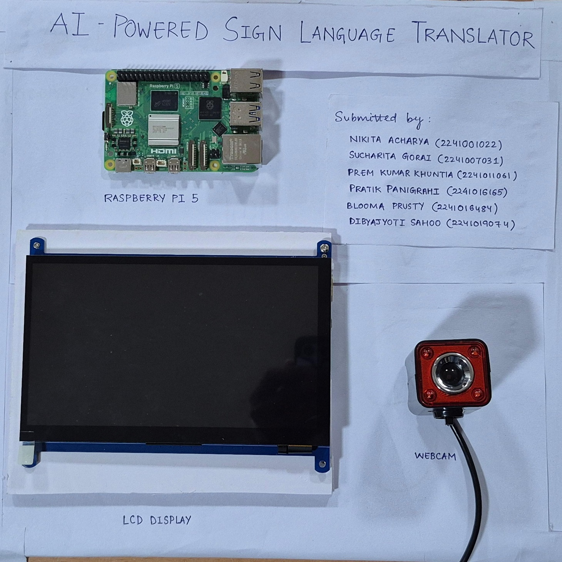
DESIGN SCHEME
PROTOTYPE OF THE PROJECT
The system uses a Raspberry Pi 5 as the central processing unit.
A USB webcam captures hand gestures made in sign language.
Captured video frames are processed using AI-based hand gesture recognition models.
The recognized sign is translated into text.
The translated output is displayed on a 7-inch LCD screen in real time.
The system is designed to be compact, cost-effective, and standalone — ideal for assistive applications.

Slide 6
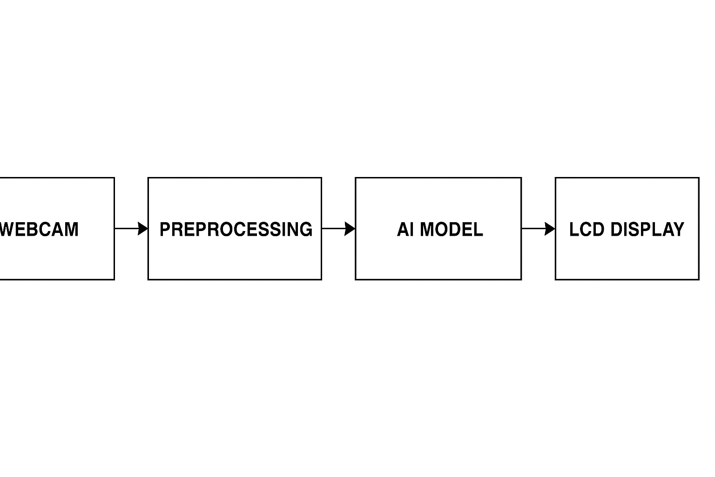
DESIGN SCHEME
nput: Live gesture captured via webcam.
Preprocessing: Image resized and normalized.
Model Inference: CNN-based or MediaPipe model processes gesture.
Classification: AI model maps gesture to character/word.
Output Display: Result is sent to LCD for visual output.
BLOCK DIAGRAM OF THE PROJECT
Input: Live gesture captured via webcam.
Preprocessing: Image resized and normalized.
Model Inference: CNN-based or MediaPipe model processes gesture.
Classification: AI model maps gesture to character/word.
Output Display: Result is sent to LCD for visual output.

Slide 7
The Webcam Starts :
As soon as we start the program, our webcam turns on which is connected to the Raspberry Pi.
Raspberry Pi Processes the Video :
The Raspberry Pi runs the main Python program.
The program uses MediaPipe, a tool made by Google
Machine Learning Model (AI Brain) :
The Raspberry Pi loads the trained CNN model.
It feeds the hand data (like shape and position) to the model.
Prediction :
The model predicts what letter or word the sign represents.
Display the Result :
Once the prediction is made, it’s shown on the screen as text.
HOW MODEL WORKS

Slide 8

TRAINING OF THE MODEL
Collected Images of Hand Signs
We first created a dataset of hand gestures.
We resized all images to the same size (like 64x64 or 128x128 pixels). Converted them to grayscale or RGB format
Preprocessed the Images
Trained a Machine Learning Model
We used a Convolutional Neural Network (CNN), a special kind of AI that’s very good at recognizing images.
We let the model train for several epochs (rounds), so it could improve and correct itself.
Trained The Model
Once the model was trained well, We saved it as a .h5 file
Saved The Model

Slide 9
HOW CNN AND OUR MODEL ARE LINKED
Our model leverages Convolutional Neural Networks (CNNs) for feature extraction.
CNN layers automatically identify important patterns from input data (e.g., images, signals).
The extracted features are then processed by our custom architecture for specialized tasks.
CNN provides robust learning of spatial hierarchies, improving model accuracy.
Integration with CNN allows our model to handle complex inputs efficiently.
This linkage enables end-to-end training, optimizing both CNN and our model components jointly.

Slide 10
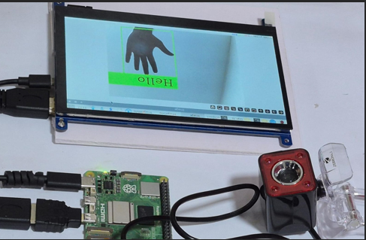
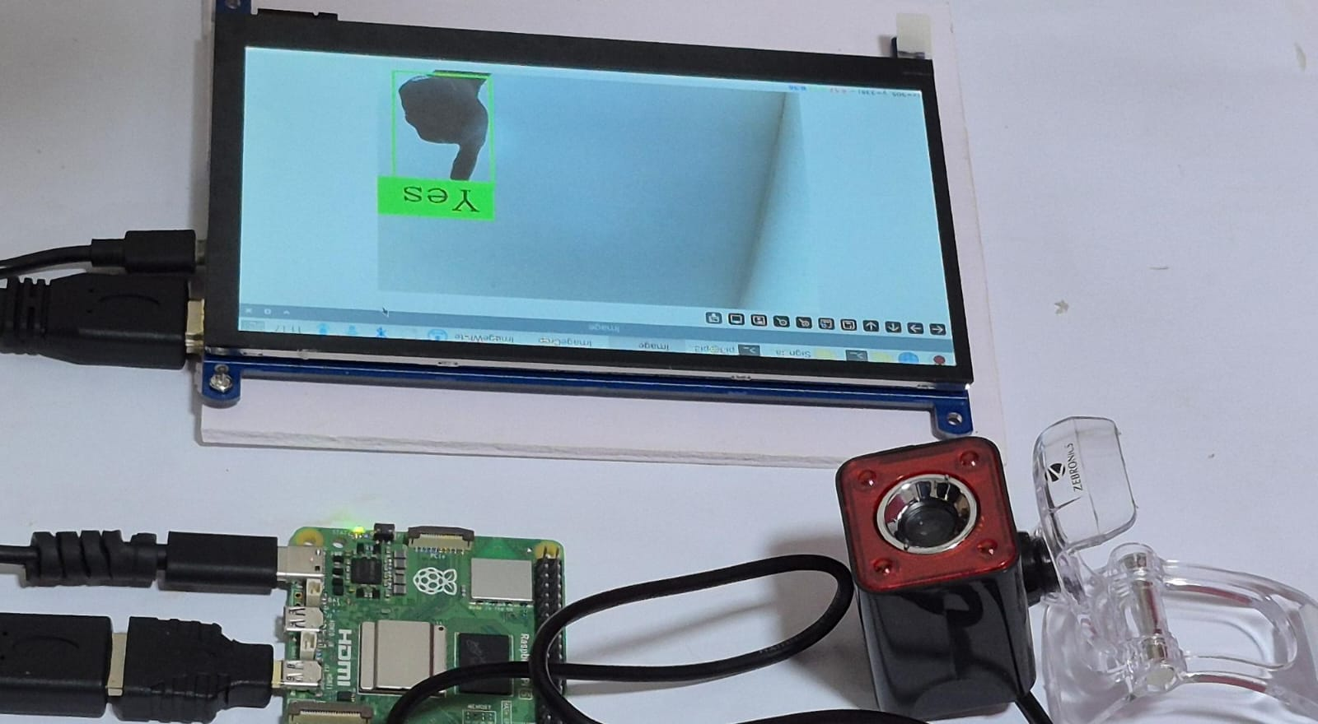
RESULT AND ANALYSIS
Detected with ~92% accuracy in well-lit environments; works best with frontal hand raise gesture.
Real-time Detection Speed:
~15 FPS achieved with light AI model optimized for Raspberry Pi 5.
Recognized with ~85% accuracy; sometimes confused with similar nodding/hand tap gestures.
Best Accuracy Conditions:
Good lighting, plain background, stable camera angle.

Slide 11
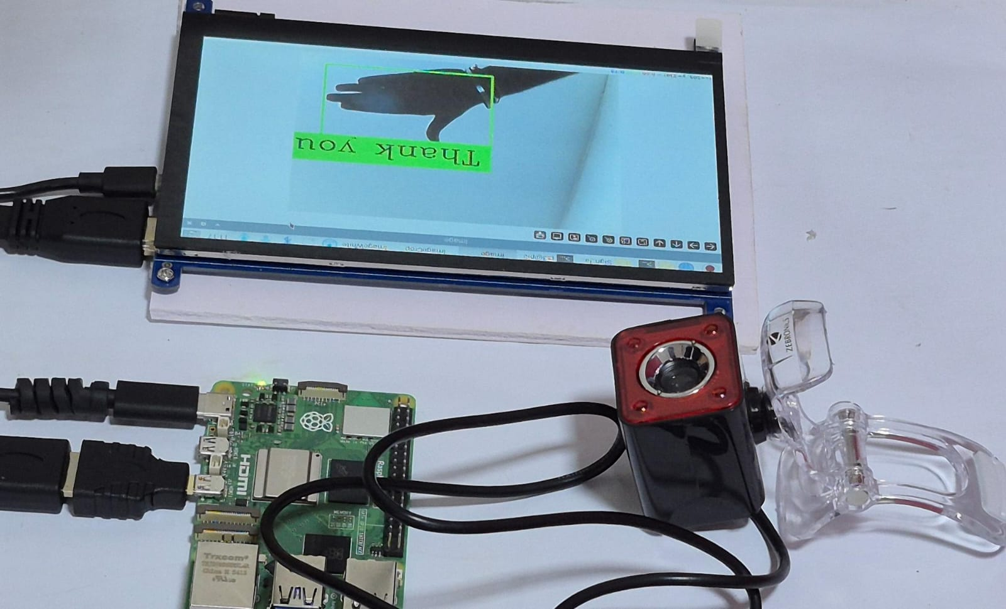
RESULTS AND ANALYSIS
Achieved ~88% accuracy; minor misclassification if hand motion is too fast or partial.
Response Delay:
~0.5–1 second delay between gesture and translated output on screen.

Slide 12
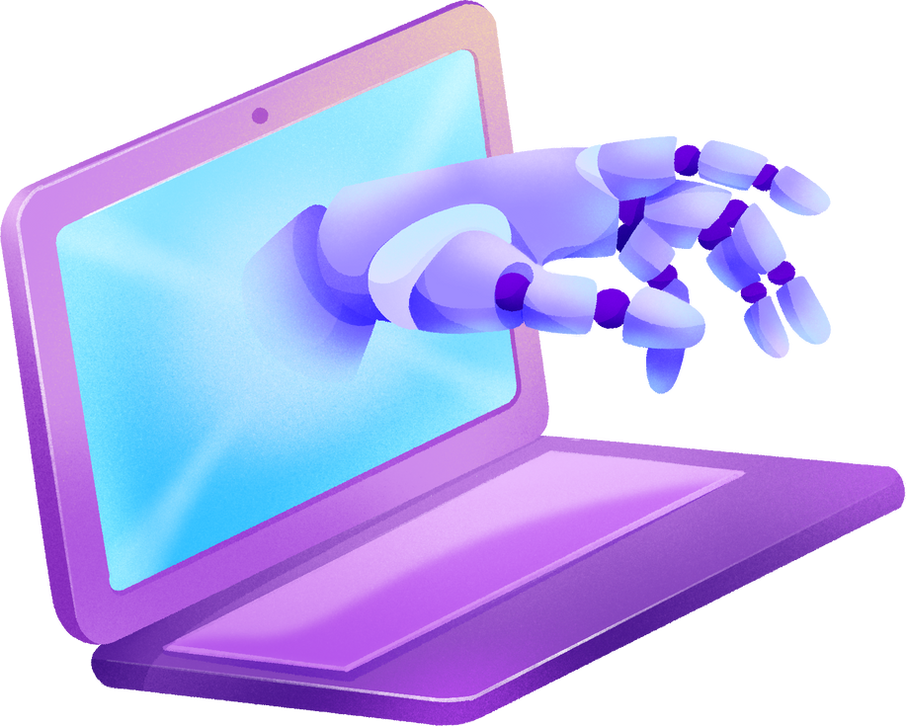

ENGINEERING TOOLS
Raspberry Pi 5
Core processing unit for AI inference and peripheral control.
HDMI-Compatible Touchscreen Display
Displays translated sign output and user interface.
USB Webcam
Captures real-time video for sign language detection.
Type-C Power Adapter
Supplies reliable DC power to the Raspberry Pi.
GPIO Jumper Wires (if used)
For connecting LEDs or extra components for output signaling.
Heat Sink or Cooling Fan
Prevents overheating during continuous AI processing.
Multimeter
Checks power flow and verifies voltage stability for the Raspberry Pi setup.

Slide 13
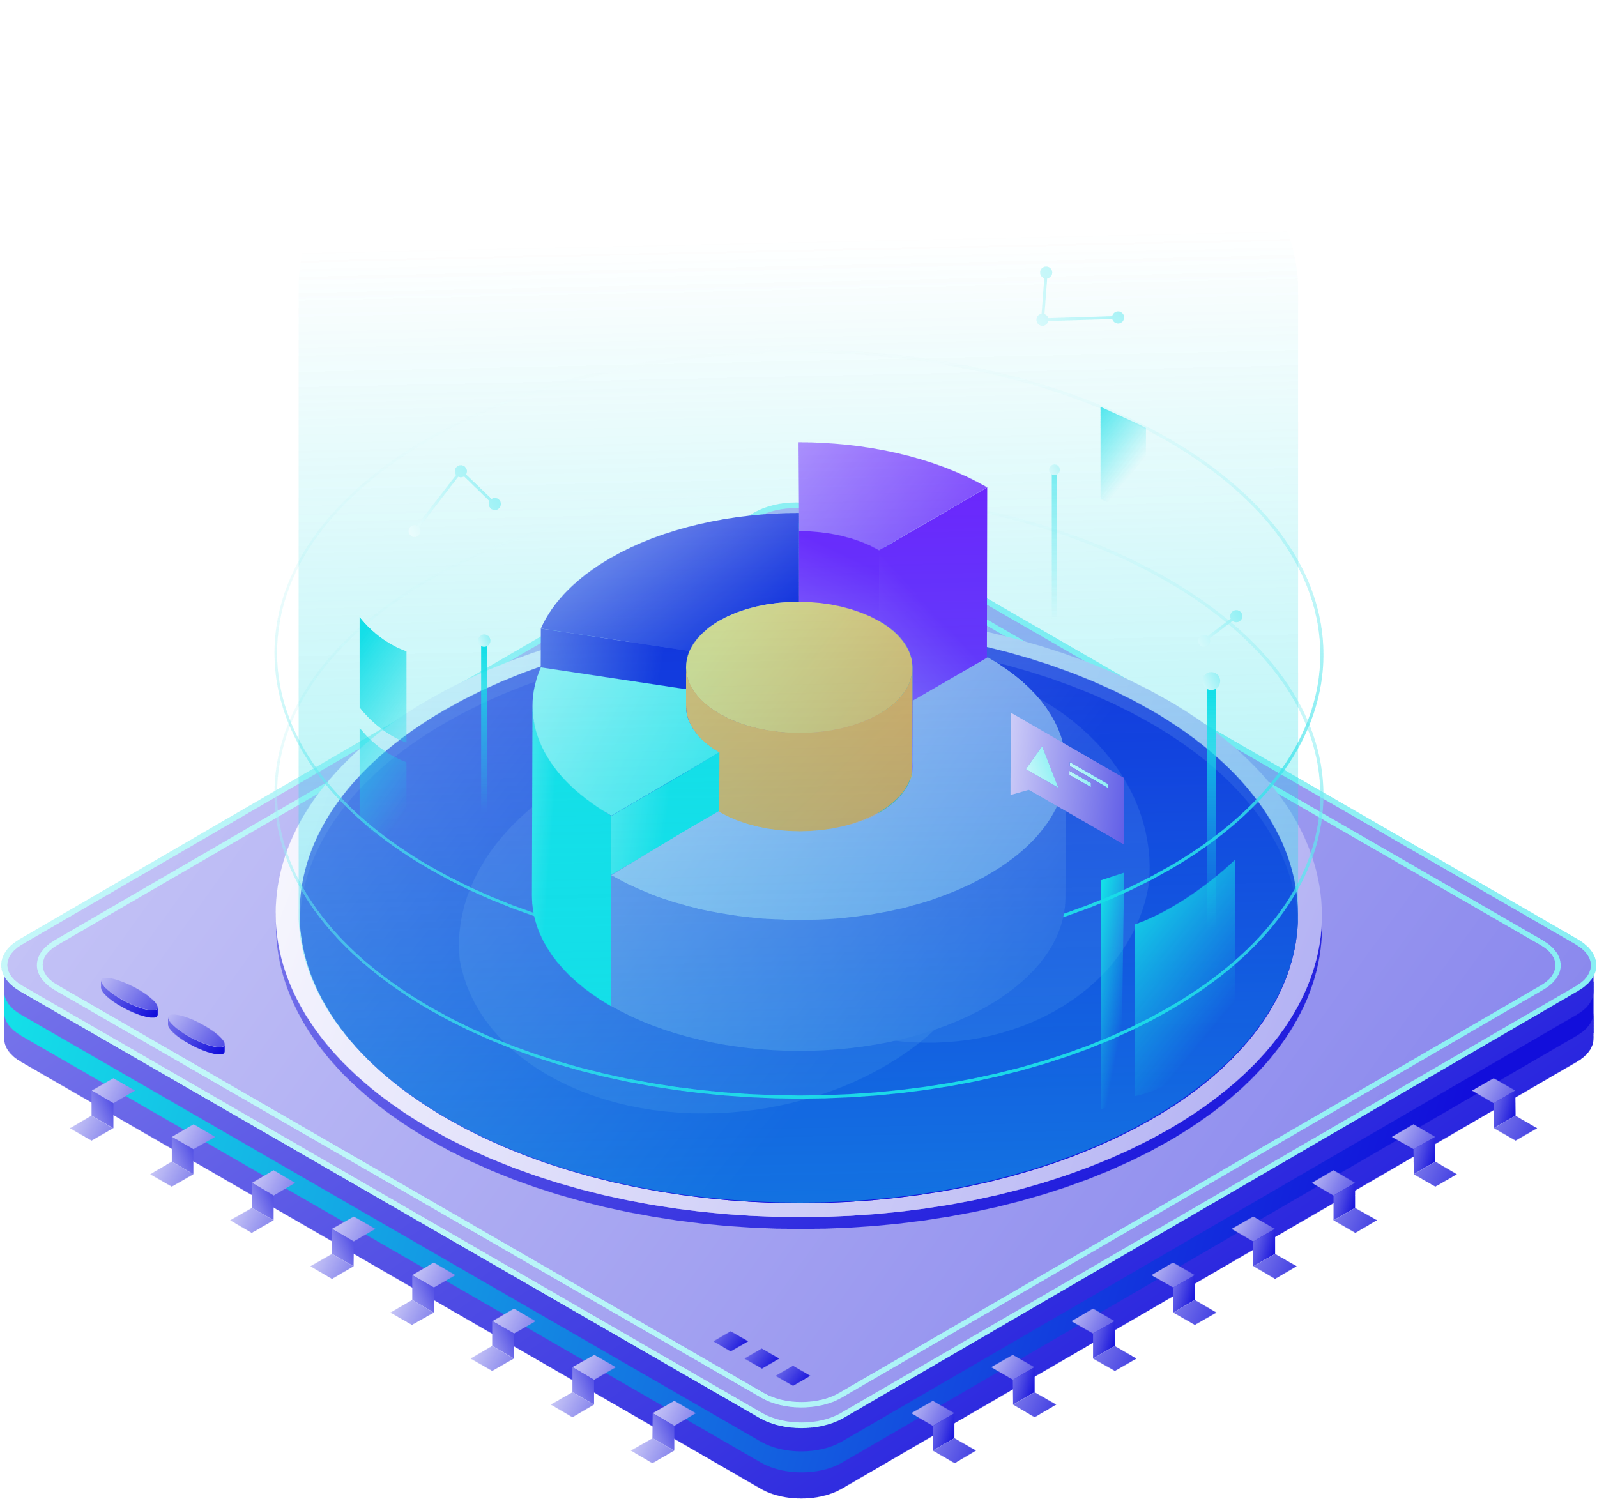
CHALLENGES FACED
Hardware Compatibility Issues
Ensuring proper driver and software support for the touchscreen panel and webcam on Raspberry Pi 5.
Power Supply Stability
Maintaining a stable Type-C DC power source to prevent performance drops or reboots.
USB Bandwidth Limitations
Managing USB ports for webcam and touchscreen without overloading the controller bandwidth.
Camera Frame Rate & Resolution
Balancing resolution and frame rate for real-time sign detection without lag.
Lighting & Background Noise
Achieving consistent detection accuracy under different lighting and background conditions.
Real-Time Inference Speed
Optimizing model performance to detect signs instantly despite limited onboard resources.
Model Training Dataset
Finding or creating a high-quality dataset of sign language gestures for accurate predictions.
Touchscreen Calibration
Adjusting touchscreen input accuracy to align correctly with the GUI.
Temperature Management
Preventing overheating during prolonged usage of camera and processor under AI load.

Slide 14
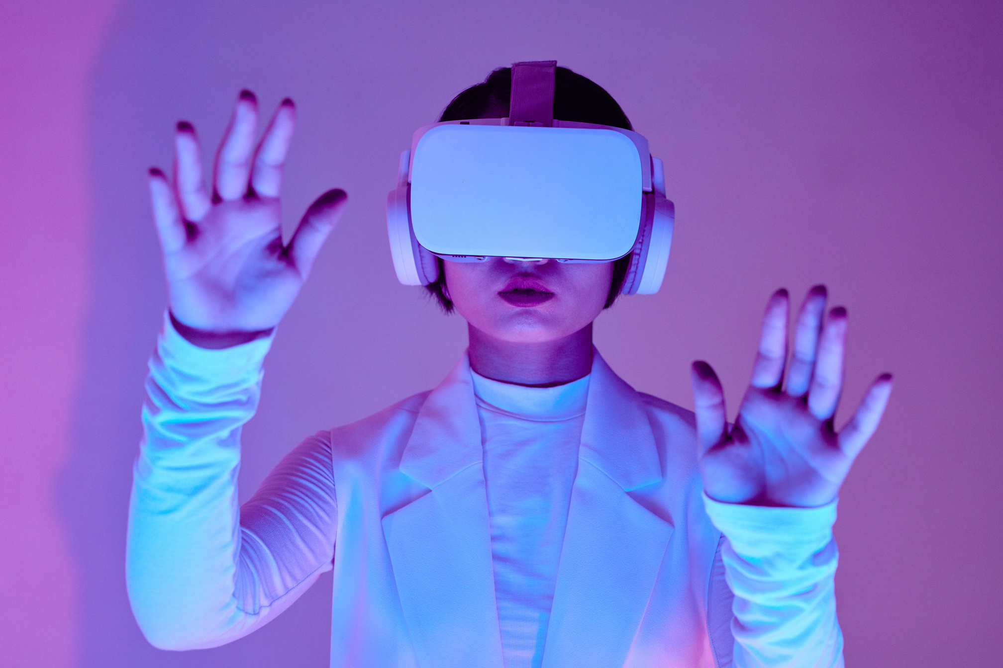
FUTURE WORK
Emotion + Sign Recognition
Combine facial emotion detection with gesture recognition for deeper communication analysis..
Voice Output for Signs
Integrate text-to-speech so that translated signs are spoken aloud for real-time communication..
Support for Full Sign Language Dictionary
Expand model to recognize complete ASL/ISL alphabet, words, and sentence structures.
Integration in Public Services
Deploy in hospitals, banks, railway stations to assist hearing/speech-impaired individuals.

Slide 15
CONCLUSION
The development of the AI-powered sign language translator using Raspberry Pi has proven to be a successful step toward bridging the communication gap between hearing-impaired individuals and the wider community.
By leveraging computer vision and machine learning, the system accurately recognizes hand gestures in real-time and translates them into both text and speech outputs.
This project demonstrates that a low-cost, portable, and offline-capable solution can be built using readily available hardware like the Raspberry Pi, combined with AI models trained on sign language datasets.
The system performs effectively under ideal conditions and offers an accessible interface that can be used in various real-world environments such as schools, healthcare centers, public service counters, and homes.
In conclusion, this project not only showcases the practical application of AI and embedded systems in assistive technology but also contributes meaningfully toward making communication more inclusive and accessible for all.

Slide 16
REFERENCES
Zimmerman, T., & Lanier, J. (1989). A hand gesture interface device. SIGCHI Bulletin, 21(2), 189–192.
Starner, T., Weaver, J., & Pentland, A. (1998). Real-time American Sign Language recognition using desk and wearable computer based video. IEEE TPAMI, 20(12), 1371–1375.
Kadous, M. W. (2002). Machine recognition of Auslan signs using PowerGloves: Towards large-lexicon recognition of sign language. Australian Computer Science Communications.
Molchanov, P., Gupta, S., Kim, K., & Kautz, J. (2016). Hand gesture recognition with 3D convolutional neural networks. CVPR.
Google MediaPipe. (2019). MediaPipe Hands: On-device real-time hand tracking.
Cao, Z., Simon, T., Wei, S. E., & Sheikh, Y. (2017). Realtime multi-person 2D pose estimation using part affinity fields. CVPR.
Küçükdermenci, S. (2023). Sign language voice converter design using Raspberry Pi for impaired individuals. ICRIET, 160–166. DOI: 10.59287/icriret.1395
Thanigaivelan, V., et al. (2020). Cost effective sign language translator using Raspberry Pi with IoT. IJFGCN.
Abas, S. S. (2025). Image processing and AI for gesture recognition: Developing portable sign language solutions. IJAIET, 7(1), 10–19. DOI: 10.21608/ijaiet.2025.352663.1011
Shinde, S., Gaikwad, R., & Mohite, D. (2021). Smart Sign Language Translator using Raspberry Pi. Journal of Emerging Technologies and Innovative Research.
.

Slide 17

ANY QUESTIONS?

Slide 18
THANK YOU!

